Slide 1
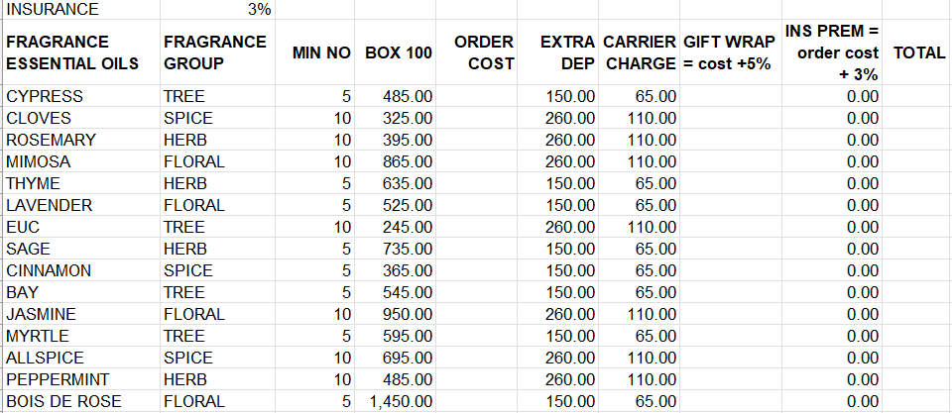
Athena House Fragrance
HOMEWORK
Using the skills learnt today transform the data for Athena House Fragrance into a working sheet.
Set out the following:
drop down box for Fragrance group
Separate each group
Add sub totals
Work out the average order cost
Work out profit of total sales based on 15%
Format as table using colour, text alignment, number formatting

Slide 2
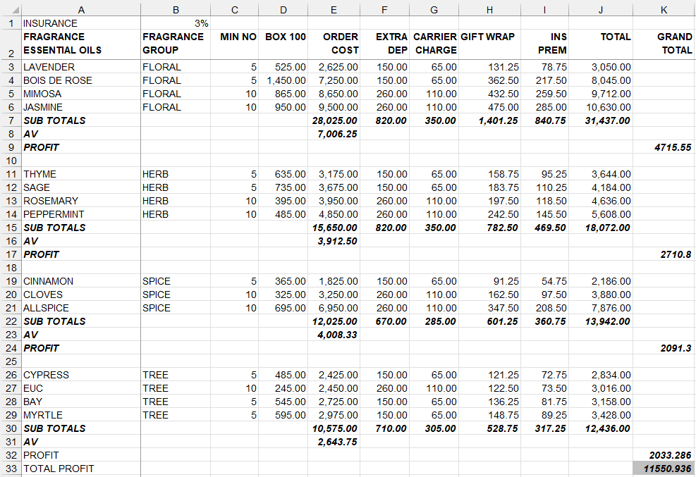
So it looks something like this

